Slide 1
Code Testing AND Grading {
intro.html | problem.html | solution.html | demo.js
[in Learning Management Systems]
<
Wee Jing Wen
U1821631A
>
}
Notes:
Good afternoon, I am Wee Jing Wen and I will be sharing about my final year project, which is about automated code testing and grading in learning management systems, otherwise known as LMSs.

Slide 2
Table Of ‘Contents’ {
01
02
03
intro.html | problem.html | solution.html | demo.js
Introduction
< Learning Management Systems (LMSs) >
Problem
< Gaps in Current LMSs and FYP Project Objective >
Proposed Solution
< Implementation and Demonstration >
}
Notes:
I’ll first be sharing a brief background on the topic of LMSs, followed by the current situation and its gaps, as well as the objective and scope of my project. Finally, I will share details of my implementation and conduct a demonstration.

Slide 3

01 {
[Introduction]
intro.html | problem.html | solution.html | demo.js
< Background: Learning Management Systems (LMSs) >
}
Notes:
Now, I’m sure all of us here have used a LMS before, since NTU uses one called Blackboard. But did you know just how many people in the world are using LMSs as well?

Slide 4
73,800,000 {
intro.html | problem.html | solution.html | demo.js
< Number of LMS users >
//as of Sept 2020
}
Notes:
As of September 2020, the number of LMS users is estimated at a whopping 73.8 million,

Slide 5
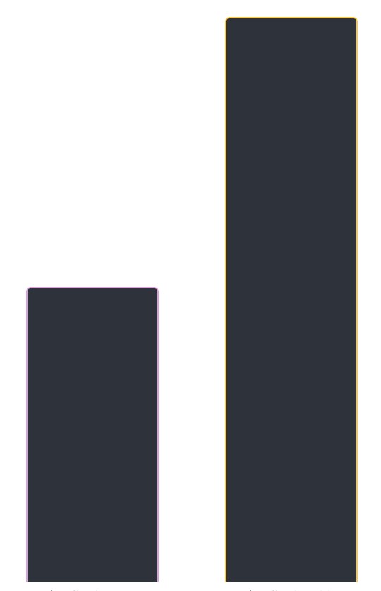
Expectations of ‘Global LMS Market Size’ {
intro.html | problem.html | solution.html | demo.js
25.7B USD
13.4B USD
}
2020
2025
Notes:
and the global LMS market size is expected to grow from 13.4 billion USD in 2020 to almost double the size, at 25.7 billion by 2025. This growth is due to the increasing digital literacy and adoption of digital learning.

Slide 6

Movement Towards ‘Digital Learning’ {
intro.html | problem.html | solution.html | demo.js
1,484,715,875
< affected learners >
84.8%
< of total enrolled learners >
173
< country-wide closures >
}
//as of 2 April 2020
Notes:
This movement towards digital learning has been further boosted by the onset of the Coronavirus outbreak. Due to social distancing, many educational institutions have temporarily shut down. As of 2 April 2020, with 173 country-wide school closures, 84.8% of total enrolled learners (close to 1.5 billion learners) have been affected by the closures. Many schools have since adopted online learning using online educational tools and platforms instead.

Slide 7

LMS; {
intro.html | problem.html | solution.html | demo.js
‘Learning Management System’
}
Notes:
One important and widely-used educational tool and platform is the LMS. There’s an increased use of it due to the growing online learning trend, but is using LMSs in education really that useful?

Slide 8


Benefits of ‘LMSs’{
intro.html | problem.html | solution.html | demo.js
Single Platform for managing educational coursework online
Online Assessment Functionalities
< quizzes and tests with automatic grading options >
}
Notes:
LMSs provide 2 major benefits.
===First, LMSs provide teachers with a single platform for managing educational coursework online. They enable educators to make course material accessible online, including lesson content and assignments.
===LMSs also offer online assessment functionalities, such as quizzes and tests, which often have automatic grading options where the quizzes and tests can be graded and scored automatically by the system, without manual grading by the teacher.

Slide 9

02 {
[Problem]
intro.html | problem.html | solution.html | demo.js
< Gaps in Current LMSs and FYP Project Objective >
}
Notes:
However, there leaves more to be desired when we look at the application of LMSs in the context of programming and coding education.

Slide 10
Gaps in LMSs for ‘Programming Education’{
intro.html | problem.html | solution.html | demo.js
Teachers need to spend time marking each assignment
< unable to use their time on more fruitful things that cannot be automated >
Lack of Automated Grading Functions
Students cannot get immediate feedback on their learning
< unnecessary delay in feedback can affect knowledge retention and learning motivation >
< for programming and coding assignments >
}
Notes:
In the market today, LMSs generally lack automated grading functions for programming and coding assignments. As such, one of the major benefits of using LMSs as mentioned earlier is not reaped.
===As a result, teachers are required to grade each assessment individually and are unable to use their time on more fruitful things that cannot be automated, such as coming up with lesson plans etc.
===Furthermore, this means students must wait longer to receive feedback on their assignment, which can affect their knowledge retention and learning motivation.

Slide 11
Gaps in LMSs for ‘Programming Education’{
intro.html | problem.html | solution.html | demo.js
External automated code grading tools
< cannot integrate smoothly into existing LMSs → have to use as second platforms >
Need for Multiple Platforms
< if external code grading tools are used >
}
Notes:
To overcome the lack of automated code grading functions, educators can use external tools such as Web-CAT which can automatically grade programming assignments. However, such external tools cannot integrate smoothly into existing LMSs. This means that in order to make use of such external tools, educators often have to use these external tools as a second platform to manage coding assignments.
===This then diminishes a key benefit of using LMSs which is the ability for LMSs to act as a single platform to manage all coursework materials.

Slide 12
Project Objective; {
intro.html | problem.html | solution.html | demo.js
‘To solve the lack of an automatic grading system for coding assignments in LMSs’
<p>
Implement an automated code testing and grading feature and integrate it into an existing LMS program
</p>
}
Notes:
Therefore, my project aims to solve the gap and confer programming educators and students the mentioned benefits of using LMSs
===by implementing an automated code testing and grading feature in an existing LMS program.

Slide 13



‘Significance’ of project {
intro.html | problem.html | solution.html | demo.js
Benefits of automated grading:
Provides immediate feedback in the form of scores
Efficient long-term knowledge retention
Engages and motivates students
Makes learning more active
}
Notes:
Implementing this automated grading feature will allow educators and students in programming and coding education to reap the benefits of using LMSs.
===To add on to that, a key benefit of having automated grading is the provision of immediate feedback for students’ work.
===Immediate feedback is more efficient for learning of complex content and for building long-term knowledge retention. When learning is followed with immediate feedback, students can absorb or act on it while it is contextual to present learning and top of mind.
===Giving feedback instantly also engages students in the learning and
===makes learning a more active rather than passive experience. These benefits are lost due to the lack of automated grading for coding assignments.

Slide 14

03 {
[Proposed Solution]
intro.html | problem.html | solution.html | demo.js
< Implementation Details and Demonstration >
}
Notes:
Therefore, my project will implement an automated code grading feature to address the issues mentioned.

Slide 15
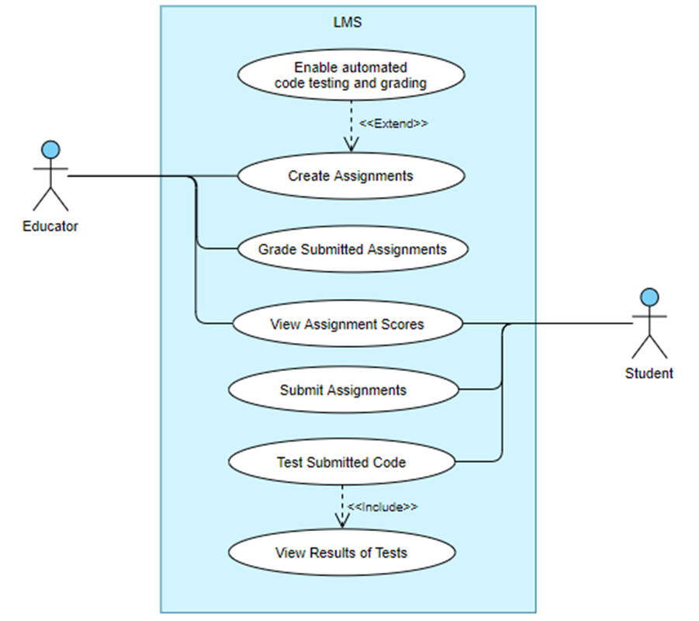
Features and Use Cases; {
intro.html | problem.html | solution.html | demo.js
‘Automated code testing and grading function for assignments’
}
Notes:
These are the key use cases of the proposed feature.
Among these, the key requirements are that educators should be able to enable the automated code testing and grading feature when creating assignments, and students should be able to test their submitted code against specified test inputs as well as their own inputs. Students should also be able to immediately see their scores for the coding assignments, thus gaining immediate feedback for their learning and reaping the benefits of immediate feedback.

Slide 16



‘Technologies’ used {
intro.html | problem.html | solution.html | demo.js
Frontend: Reactjs
Backend: Node.js
Backend Database Management: MySQL
}
Notes:
I will now share some of the technologies used for the project. As the time frame of the project is relatively short, things that are easier to pick up or learn were chosen. Additionally, as my project builds on existing code, the technologies used have been chosen to be consistent with the existing code.
For the frontend LMS website, ReactJS was used.
For the backend, node.js was used.
For the backend database management, MySQL was used.

Slide 17


Code Testing: ‘Dynamic’ {
intro.html | problem.html | solution.html | demo.js
[Examines an application during or after a program is run. Executes the software and validates the output with the expected outcome to check for its functional behaviour.]
Can identify vulnerabilities in a runtime environment
Can only find defects in the part of the code that is actually executed
Can expose more complicated flaws
}
Notes:
As for the code analysis and testing method, dynamic code testing was chosen. Dynamic code analysis checks a software’s functional behavior by executing the software and validating the output with the expected outcome.
===This allows it to identify vulnerabilities in a runtime environment and expose more complicated flaws.
===While dynamic code analysis is limited in that it can only find defects in parts of the code that are actually executed, this limitation is less severe in the context of this project. This is because the most likely use case for the code testing tool is for students to test their completed and executable code assignments. Even if their code is unable to run, the result of the dynamic code testing (which will be a failure) will match the correct score the code should receive. This limitation can also be overcome using more test cases to cover all the possible paths.

Slide 18
‘Static’ Code Analysis {
intro.html | problem.html | solution.html | demo.js
[Examines an application’s source code before the program is run. Usually done by analyzing the code against a given set of rules or coding standards]
Ensure adherence to development standards
Unable to expose complicated and subtle flaws or vulnerabilities
Reduce potential production issues
Little understanding of developer intent
Able to detect bugs early
Does not find vulnerabilities introduced in runtime environment
Relatively cost-efficient
Limited by the underlying rules and guidelines
}
Notes:
An alternative I also considered is using static code analysis. Static code analysis is usually done by analyzing the code against a given set of rules or coding standards, and
===can help ensure adherence to strict development standards. However, this will not be applicable for this project as the code analysis will be used in the automated code testing function to test for the functionality of the code, and is not meant to check for adherence to coding standards.
===Static analysis may also be relatively cost-efficient as it is able to detect bugs at an earlier phase of the software development life cycle. However, as the assignments for which code testing is enabled are likely smaller-scale code and simple functions instead of large applications, the cost of fixing a bug is not likely to be a big concern.
===Furthermore, static code analysis is unable to expose overly complicated and subtle flaws or vulnerabilities, and
===does not find vulnerabilities introduced in the runtime environment.
===It is also limited by the underlying rules and guidelines, and generally does not support all programming languages. While it may be possible to update and enhance the rules to support many programming languages, it may be more feasible to use dynamic code testing, which can be conducted against any application. This is important as the code assignments may require the use of different programming languages.
Therefore, I have chosen to use dynamic code analysis in my automated code grading function.

Slide 19

Demo {
intro.html | problem.html | solution.html | demo.js
Create Assignment (code testing disabled)
Create Assignment (code testing enabled)
Submit Assignment (no code testing)
Submit Assignment (test against test cases, test against own input)
View Scores
}
Notes:
Now, I will do a short demo on my implemented feature.

Slide 20
Future Work {
intro.html | problem.html | solution.html | demo.js
Support for different programming languages
Additional function to detect the file type and spawn the respective child process
Integrated code editor
Increase convenience
Optimization
Better optimization for higher scalability
}
Notes:
I have to acknowledge that the implemented feature is not perfect and more can be done to improve the feature.
===For example, the automated code grading feature can be extended in the future to support different programming languages, as it currently only supports python code submissions. To support different languages, an additional function to detect the file type and spawn the respective child process can simply be added without having to change the way the test cases’ input and output values are stored and displayed or the way the function is called.
===Further, in order to make the system more comprehensive, a code editor can be integrated such that students may directly code on the LMS instead of coding on a separate environment and only submitting the code in the LMS. This can help increase convenience for students who may have to test and edit their code multiple times.
===Additionally, as the current system spawns a child process for each input value, this can cause large latency if there are many test cases, or if many students attempt to test their code at the same time. To account for the likely large number of students in each course, this system will need to be optimised to support the scale.

Slide 21

intro.html | problem.html | solution.html | demo.js
Conclusion; {
}
Notes:
In conclusion, this project tackled the lack of an automatic grading system for coding assignments in LMSs by implementing a code testing and grading feature and integrating it into an existing LMS program. This provides two key benefits—it allows programming students to receive immediate feedback on their online code submissions, thus aiding in their learning, and also saves the time and effort of educators. As the world increasingly adopts online learning, with this feature, programming students and educators will also be able to reap the full benefits of an LMS in their learning and teaching experience.

Slide 22
intro.html | problem.html | solution.html | demo.js
Thank You; {
‘Do you have any questions?’
}
Notes:
Thank you!

